Slide 1


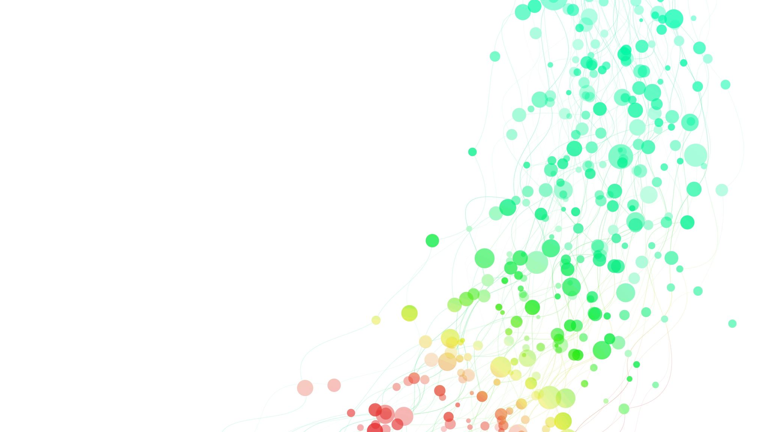


Web Development - Website for Gardening

Slide 2


The Art of Web Design
Web design encompasses a diverse range of skills and disciplines, from graphic design and interface development to user experience optimization and search engine optimization.
It is a dynamic field that requires a deep understanding of both technical and creative elements to create engaging and effective online experiences.
K

Slide 3
Interface Design: Crafting Intuitive Experiences
Responsive Design
Intuitive Navigation
Visual Hierarchy
Ensuring seamless experiences across devices, from desktops to mobile, is crucial for effective interface design. Responsive techniques adapt the layout and content to provide optimal usability on any screen size.
Clear and intuitive navigation is the backbone of a well-designed interface. Thoughtful placement of menus, links, and interactive elements guides users effortlessly through the website.
Strategically arranging and emphasizing content elements creates a visual hierarchy that draws the user's attention to the most important information. This enhances overall comprehension and engagement.

Slide 4

Standardized Code: The Foundation of Web Development
1
HTML
HTML, the backbone of web pages, provides the structure and content, defining the elements that make up a website.
2
CSS
CSS enhances the visual presentation of web content, allowing designers to control the layout, typography, and aesthetics of a website.
3
JavaScript
JavaScript adds interactivity and dynamic behavior to web pages, enabling features like form validation, animations, and responsive user interactions.

Slide 5

HTML: The Building Blocks
Basics
Syntax
Viewing Source
HTML is the standard markup language used to create web pages. It uses tags to denote elements like paragraphs, headings, and links.
HTML documents are plain text files with special tags surrounded by angle brackets. Proper syntax, including closing tags, is crucial for correct rendering.
Viewing the source code of other websites is a great way to learn HTML by example and understand how pages are structured.

Slide 6
Cascading Style Sheets (CSS)
1
Style Rules
2
Selectors
CSS comprises style rules that are interpreted by the browser and applied to corresponding HTML elements.
CSS selectors target specific HTML elements, such as by tag name, class, or ID, to apply styles.
3
Cascading
4
Flexibility
The "cascading" in CSS refers to how styles are applied, with more specific rules taking precedence over more general ones.
CSS allows for easy styling and formatting of web pages, separating content from presentation.

Slide 7




JavaScript: Interactivity and Functionality
Syntax Basics
Operators
Data Types
Functions
JavaScript has its own syntax rules for variables, operators, and statements that must be followed.
JavaScript provides a variety of operators, including arithmetic, logical, and assignment operators.
JavaScript has several built-in data types, such as numbers, strings, and booleans, that affect how values are handled.
Functions allow you to encapsulate and reuse blocks of JavaScript code for specific tasks.

Slide 8
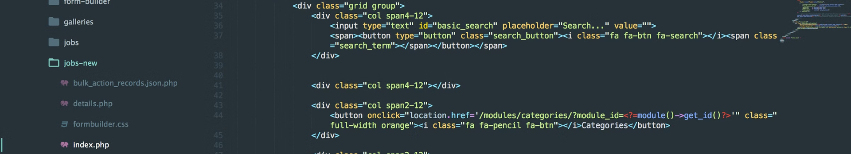



PHP: Server-Side Scripting
What is PHP?
Installation
Integration with IIS
PHP is a widely-used open-source scripting language that is especially suited for web development and can be embedded into HTML.
PHP can be easily installed on Windows systems by downloading the Windows Binaries and configuring the necessary settings.
PHP can be integrated with the Microsoft IIS web server, allowing for seamless server-side processing of dynamic web content.

Slide 9
MySQL: The Database Foundation
Feature
Description
Performance
MySQL is known for its speed and efficiency in executing queries and returning results.
Open-Source
MySQL is an open-source database, allowing developers to download, modify, and use the software freely.
Reliability
MySQL provides high reliability and uptime, making it suitable for demanding applications.
Portability
MySQL can run on a variety of operating systems and hardware architectures.

Slide 10
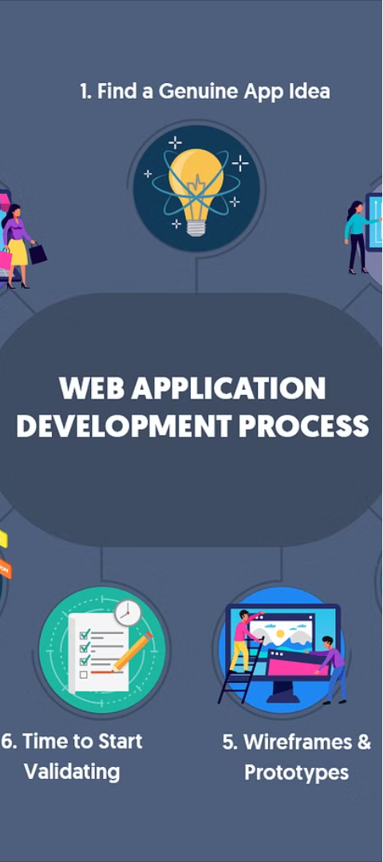
Proprietary Software: Streamlining Web Development
1
PHP
2
MySQL
A widely-used server-side scripting language that enables the creation of dynamic, database-driven websites and web applications.
A powerful relational database management system (RDBMS) that provides efficient data storage and retrieval for web applications.

Slide 11
User Experience Design: Crafting Engaging Interactions
Usability
Accessibility
Ensuring that websites are easy to navigate and intuitive to use, enhancing the overall user experience and satisfaction.
Designing for inclusivity, ensuring that websites are accessible to users with disabilities, and improving overall reach and engagement.
Personalization
Optimization
Tailoring the user experience to individual preferences and needs, creating a more engaging and relevant interaction.
Continuously improving the website's performance, content, and features based on user feedback and data analysis.

Slide 12




Search Engine Optimization: Enhancing Visibility
Keyword Research
Content Optimization
Link Building
Performance Tracking
Acquiring high-quality backlinks from reputable sources to enhance the website's authority and visibility in search results.
Identifying the most relevant and high-performing keywords to optimize content and improve search engine rankings.
Crafting engaging and informative content that is tailored to user search intent and search engine algorithms.
Continuously monitoring and analyzing website performance to identify areas for improvement and optimization.

Slide 13




Collaborative Web Design
Graphic Design
Interface Design
Web Development
User Experience
Crafting visually appealing and brand-aligned designs for the website's layout, imagery, and overall aesthetic.
Developing intuitive and user-friendly interfaces that enhance the overall experience for website visitors.
Translating design concepts into functional, standards-compliant websites using HTML, CSS, and JavaScript.
Optimizing the website's usability, accessibility, and personalization to create engaging and satisfying interactions.

Slide 14
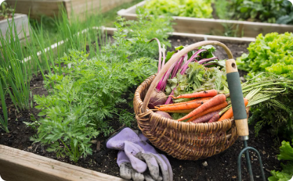


The "Website for Gardening" Project
Comprehensive Gardening Resources
Fostering Gardening Community
Streamlined Gardening Experience
The project aims to create a centralized platform that aggregates a diverse selection of gardening resources, tools, and information from various sources, serving as a comprehensive hub for gardening enthusiasts worldwide.
The platform will facilitate community engagement through features like user profiles, personalized recommendations, and forums, enabling gardeners to connect, share knowledge, and collaborate on their gardening journeys.
By centralizing gardening resources and enhancing accessibility, the project aims to simplify the gardening experience for both novice and experienced gardeners, empowering them to explore, learn, and enjoy their passion for gardening.

Slide 15
Aim and Scope of the "Website for Gardening" Project
Aim
To establish a centralized platform that aggregates a diverse selection of gardening resources, tools, and information.
Serving as a comprehensive hub for gardening enthusiasts worldwide.
Scope
The development of an intuitive and user-friendly website interface to host a diverse array of gardening resources and tools, with administrative functionalities for content management.
The inclusion of user profiles, interactive elements, and advanced search and filtering options to enhance overall

Slide 16
Conclusion: Empowering the Gardening Community
1
Accessibility and Convenience
2
Knowledge Sharing and Collaboration
3
Sustainable Living
The project seeks to promote sustainable living and environmental consciousness by providing a conducive environment for gardening enthusiasts to explore and engage in eco-friendly gardening practices.
The project aims to streamline the process of discovering, accessing, and enjoying gardening information and tools, enhancing the overall gardening experience for enthusiasts globally.
The platform will empower gardening experts and enthusiasts to share their knowledge effectively, fostering collaboration and innovation within the gardening community.

Slide 17
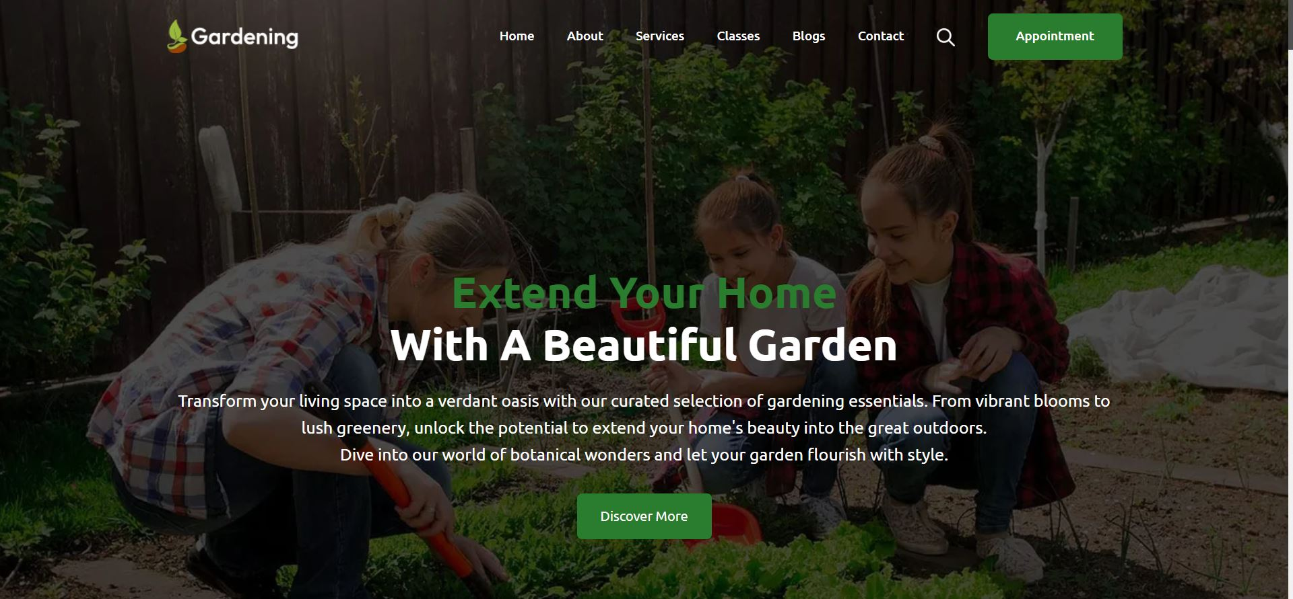
Screenshots

Slide 18
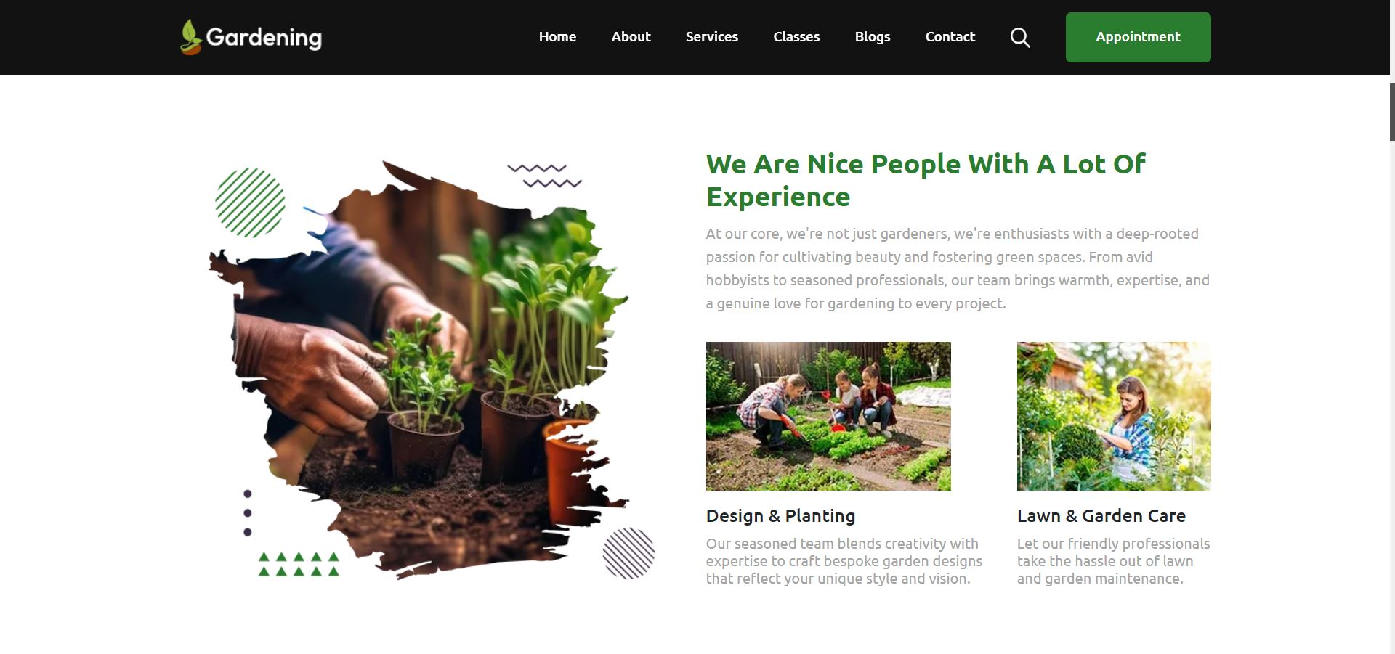

Slide 19
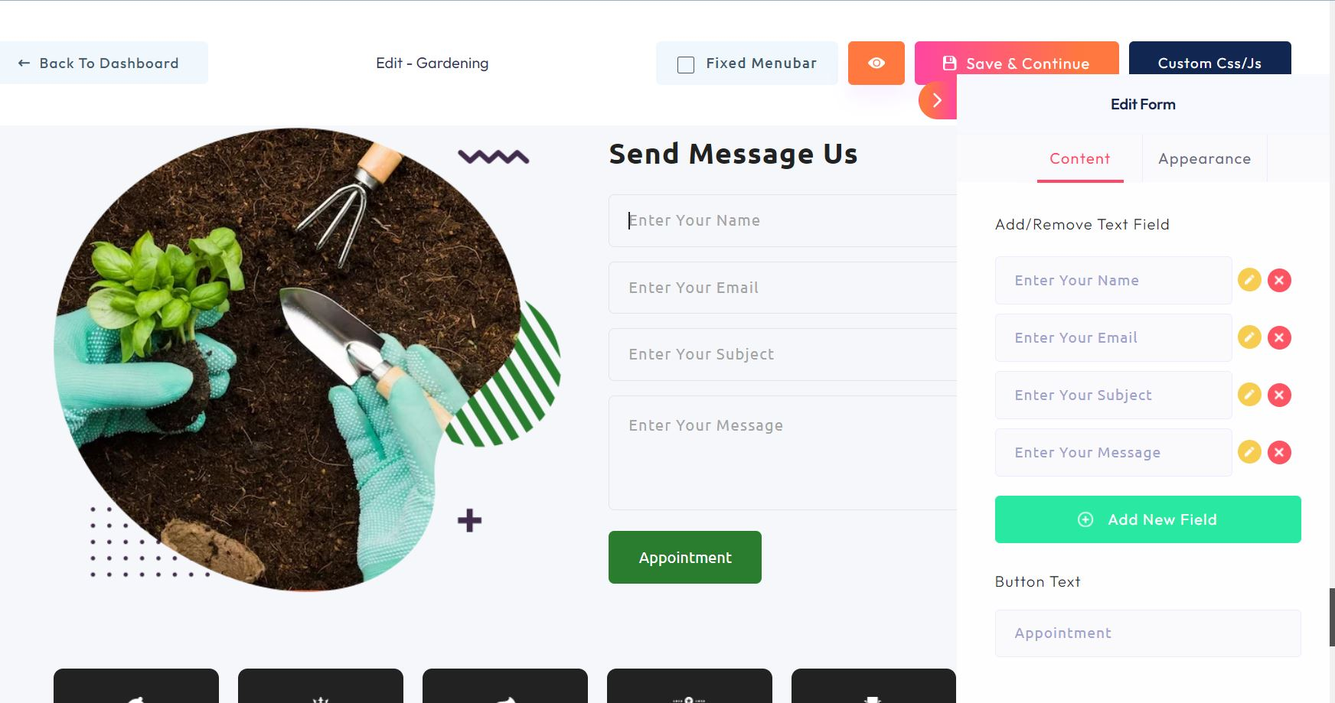

Slide 20
THANK YOU

